Slide 1

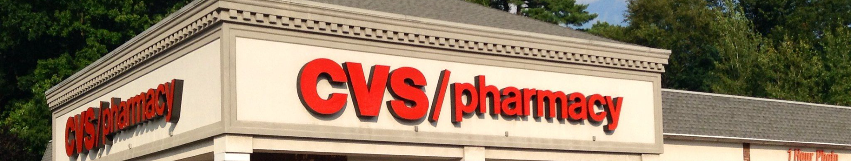
Introduction to the Medical Store Management System
The Medical Store Management System is a comprehensive software application designed to streamline and automate various operations within a pharmacy or medical store. It is tailored to handle inventory management, sales, purchases, reporting, and more, providing a centralized solution for all aspects of store management.

Slide 2

Features and benefits of the software application
1
User-Friendly Interface
2
Real-Time Inventory Tracking
3
Custom Reporting
Generate custom reports to gain insights into sales trends, inventory turnover, and other crucial metrics for informed decision-making.
The software offers an intuitive interface, enabling easy navigation and operation for all users, from store managers to sales staff.
Efficiently monitor stock levels and track product movements in real time, minimizing the chances of running out of critical items.

Slide 3

System requirements and compatibility
Minimized Hardware Footprint
Operating System Compatibility
Database Integration
Seamless integration with popular databases, offering scalability and efficient data management for growing medical stores.
The system is designed to work efficiently even with minimal hardware requirements, ensuring cost-effective implementation.
Compatible with major operating systems, including Windows, macOS, and Linux, ensuring flexibility for different store setups.

Slide 4

User interface and navigation
Intuitive Interface
Navigation Efficiency
The user interface is designed to be engaging and intuitive, reducing the learning curve for new users and enhancing overall usability.
Streamlined navigation allows for swift access to different modules, ensuring ease of use and saving valuable time during daily operations.

Slide 5
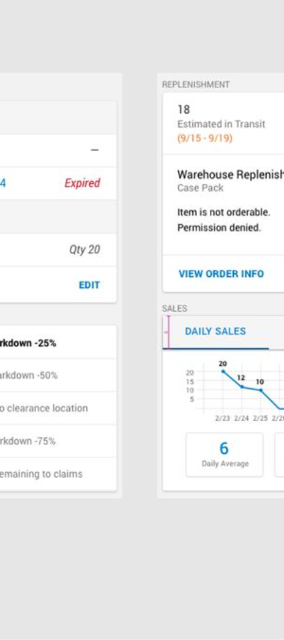
Inventory management and tracking
1
Real-Time Inventory Updates
Instant updates on stock levels and product movements to accurately track inventory changes.
2
Automated Reorder Alerts
Receive automated alerts for low-stock items, streamlining the reordering process and preventing stockouts.
3
Batch Tracking
Efficiently track individual batches of products, enabling effective recalls and expiration management.

Slide 6




Sales and purchase management
Streamlined Sales Process
Efficient handling of sales transactions, from quote to order to fulfillment, ensuring a seamless customer experience.
Purchase Order Management
Automate purchase orders, track receipts, and efficiently manage supplier relationships to optimize procurement processes.
Payment Processing
Secure and reliable payment processing solutions integrated for smooth and convenient transactions.

